Slide 1
Foreign Direct Investment Analytics
Submitted by:
Rudrani Ghosh
UNID: UM/IP/1276
College: M.Sc. Data Science at VIT, Vellore

Slide 2
Problem Statement
Investment is a game of understanding historic data of investment objects under different events but it is still a game of chances to minimize the risk we apply analytics to find the equilibrium investment.
Our aim is to understand the Foreign direct investment in India for the last 17 years from 2000-01 to 2016-17. The dataset provided contains sector and financial year-wise data of FDI in India. My task was to find key metrics and factors and show the meaningful relationships between attributes.

Slide 3
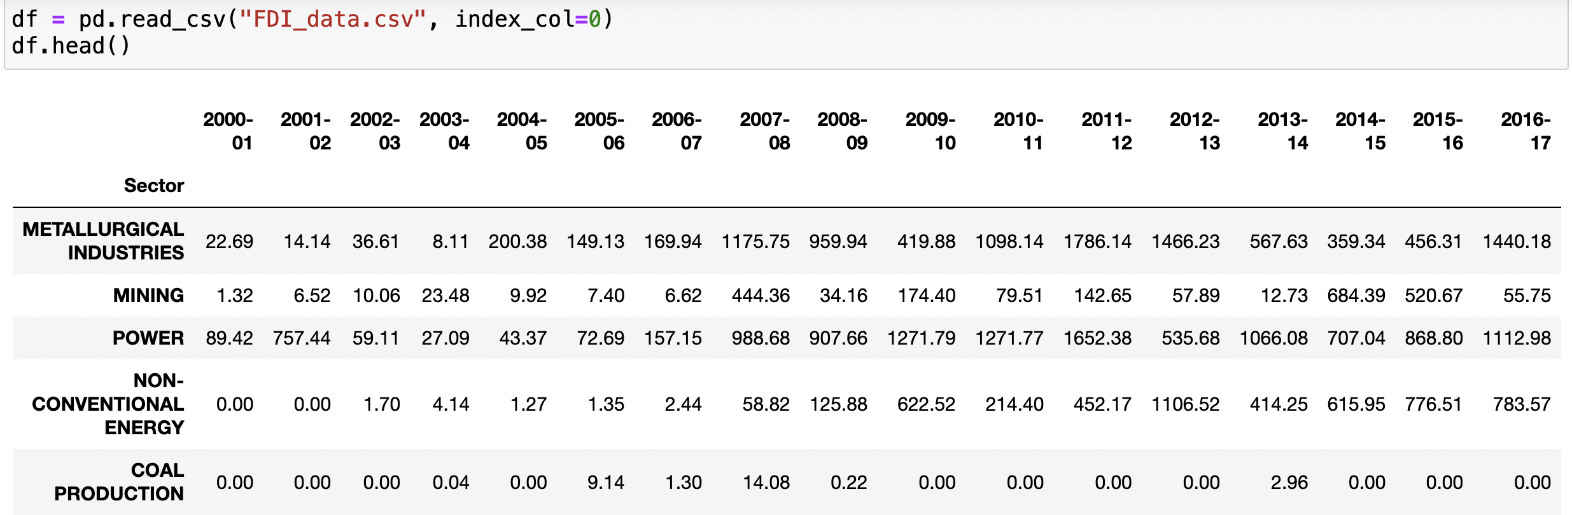
Details of Data
No of Sectors: 63
Year range: 2000-01 to 2016-17

Slide 4
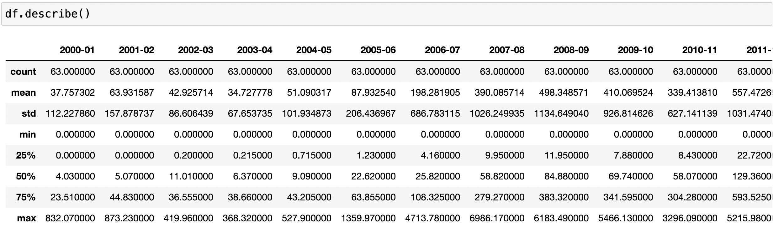

Slide 5
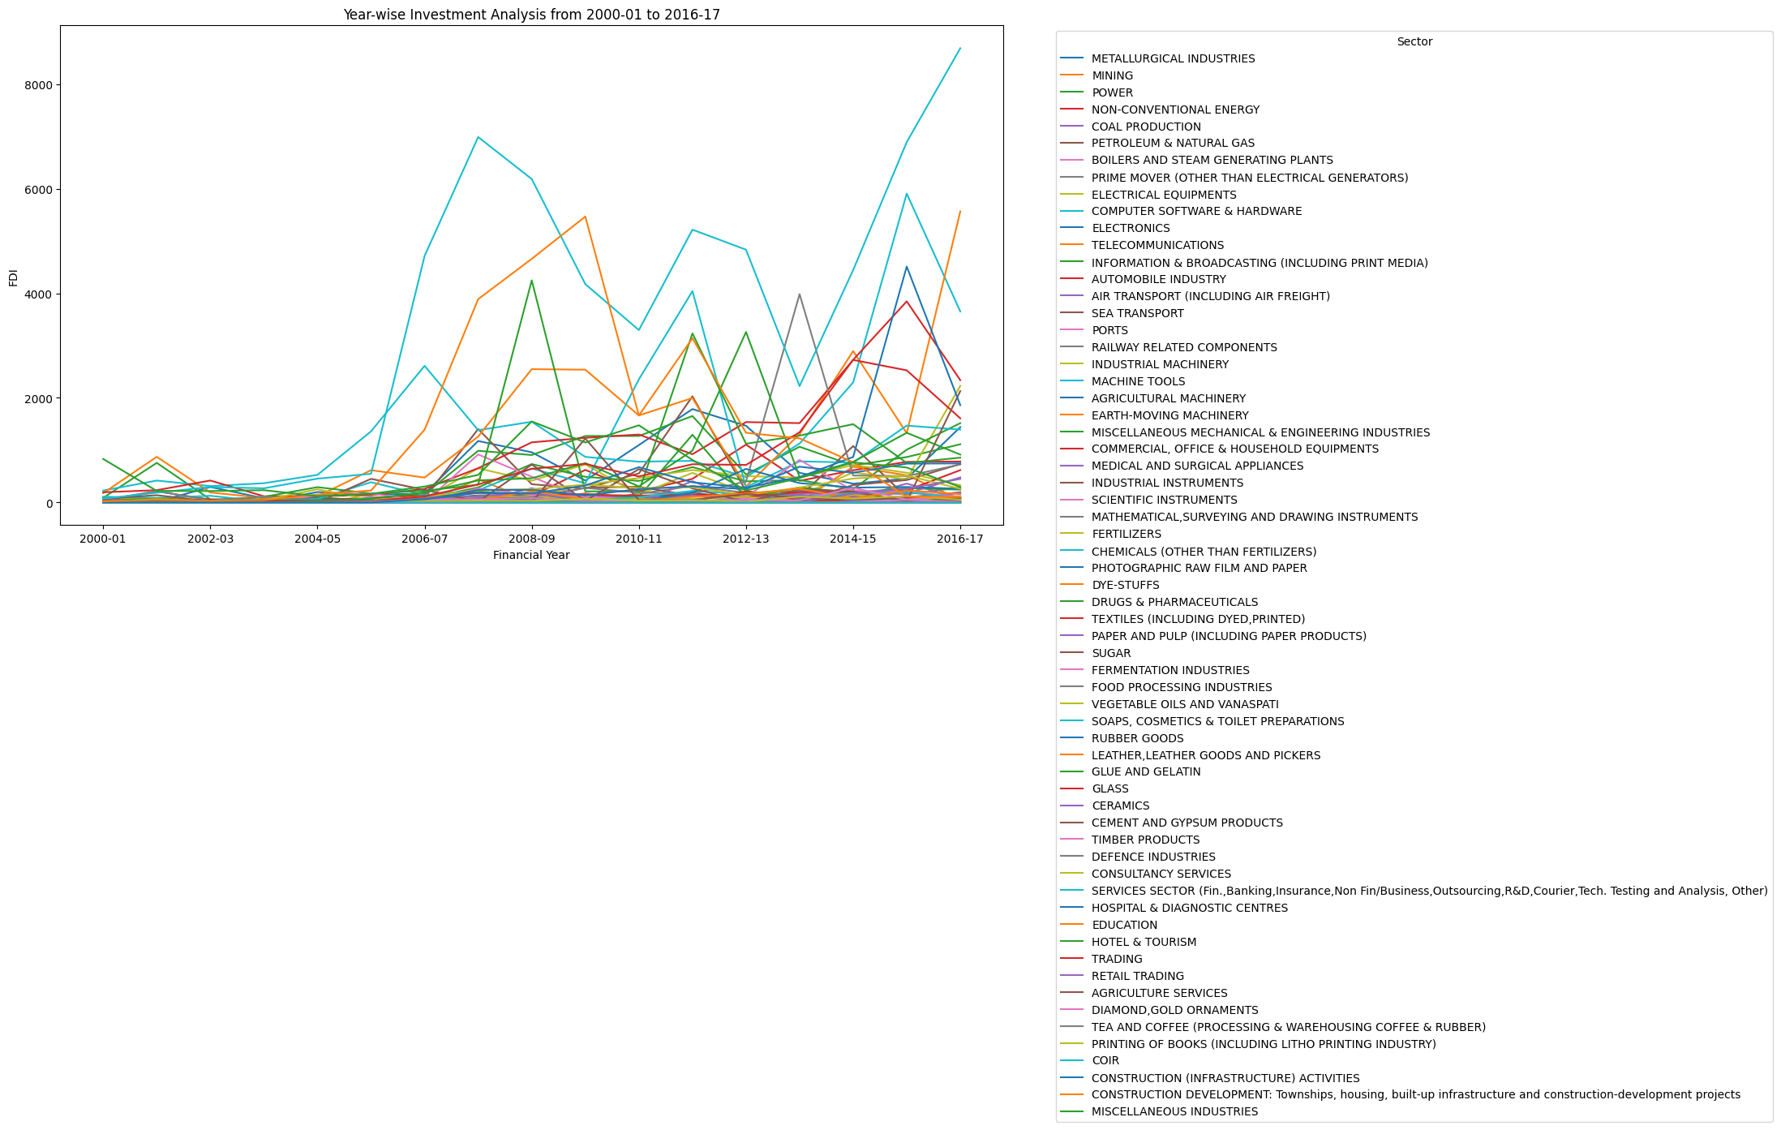

Slide 6
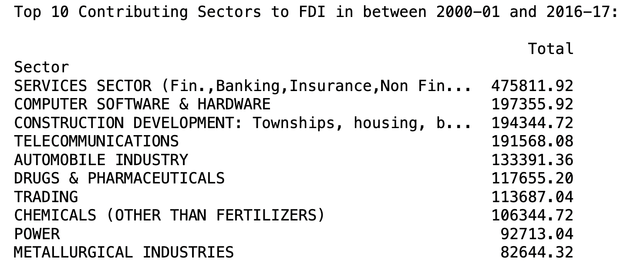
Main KPIs

Slide 7
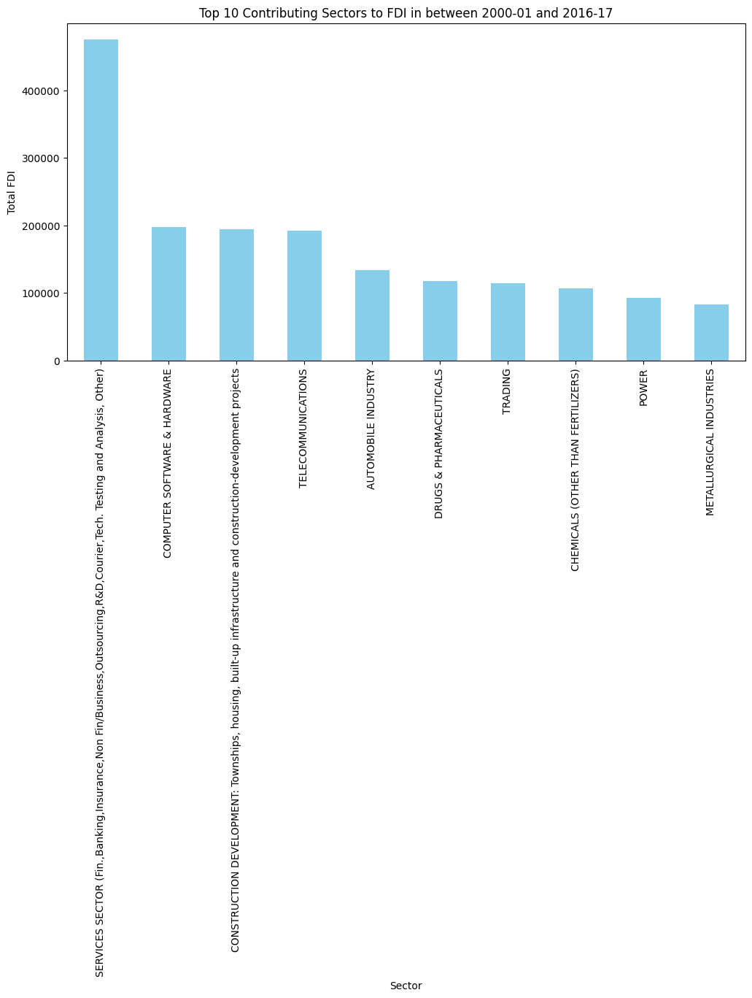

Slide 8
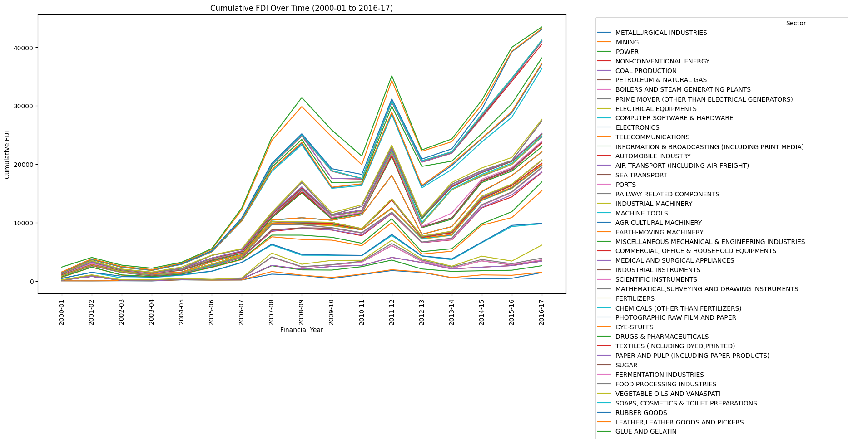
CUMULATIVE FDI GROWTH

Slide 9
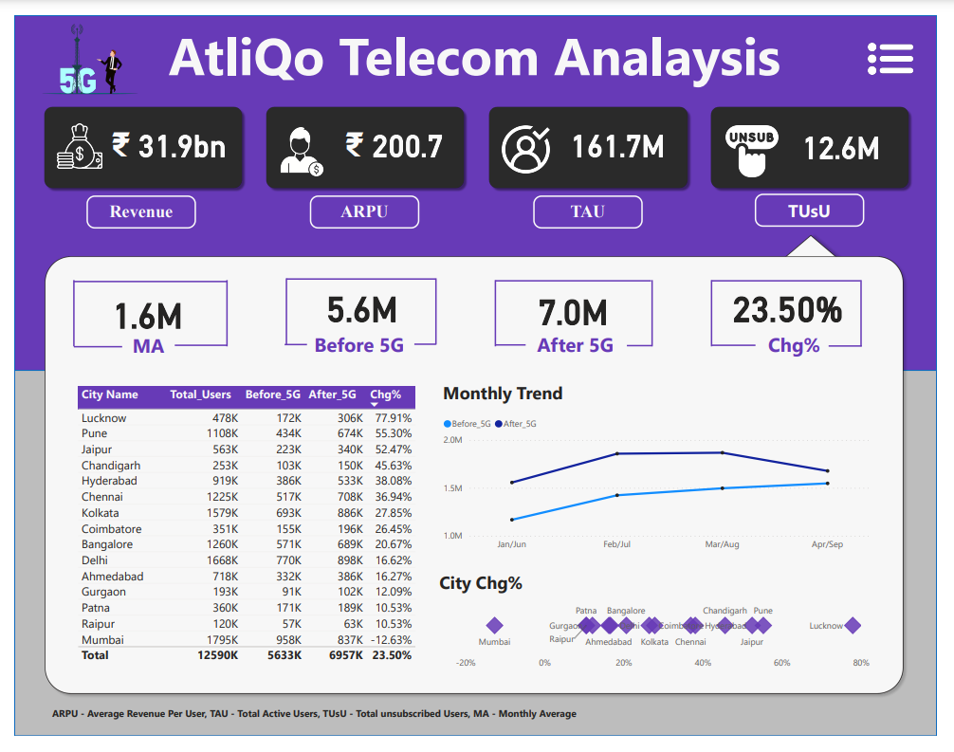
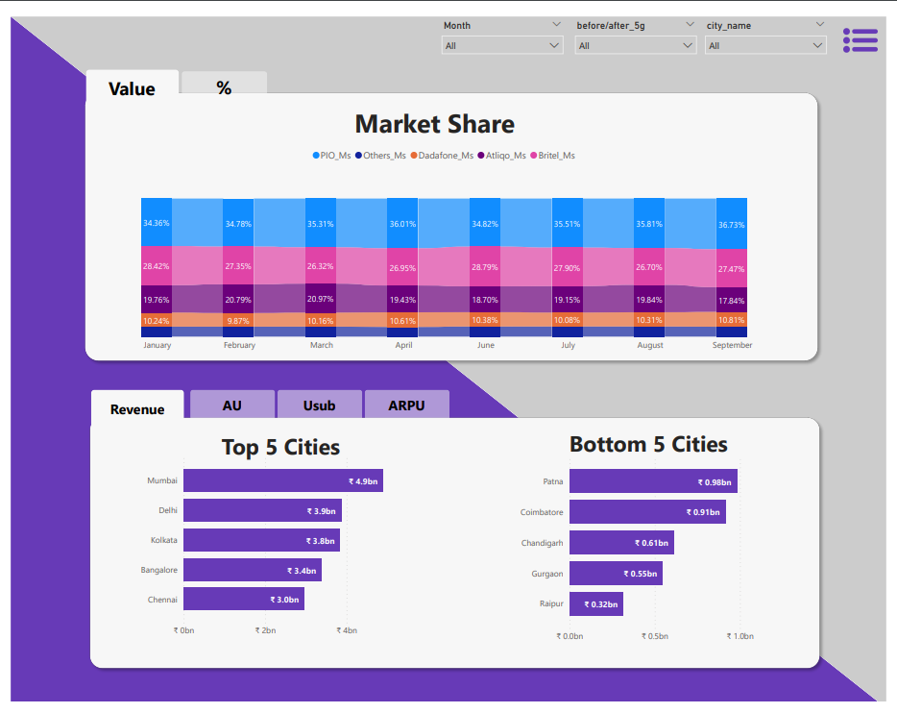
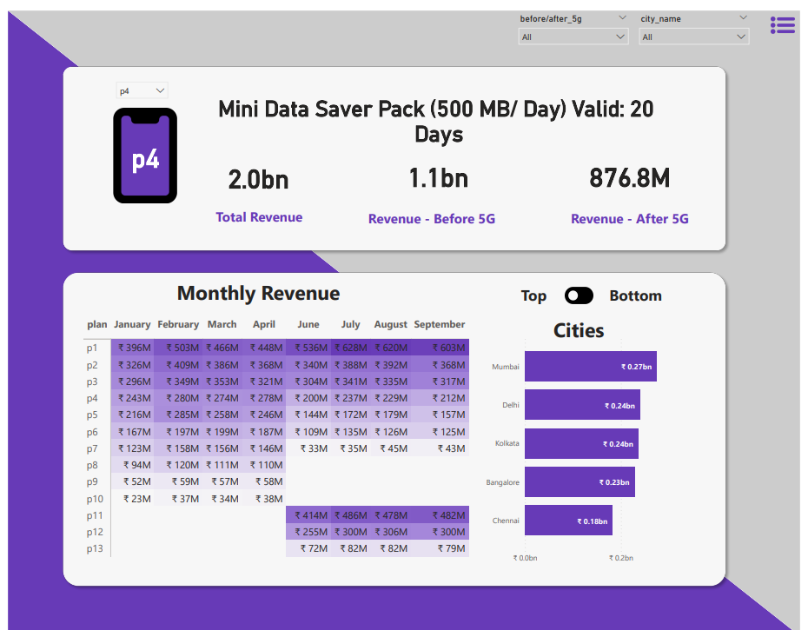
My Design

Slide 10
Thank you

